Slide 1
Pycharm Install

Slide 2
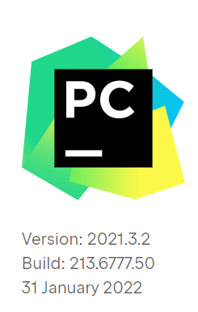
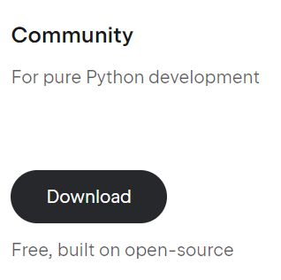
Pycharm|Install
1, Download and Install Pycharm
Search download Pycharm in google
Download Community version
Choose and click all options when you install this PGM
1 / 7

Slide 3
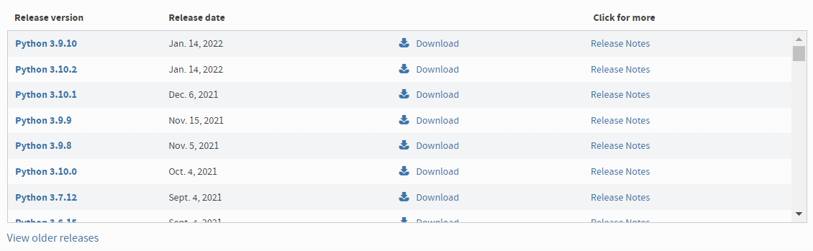
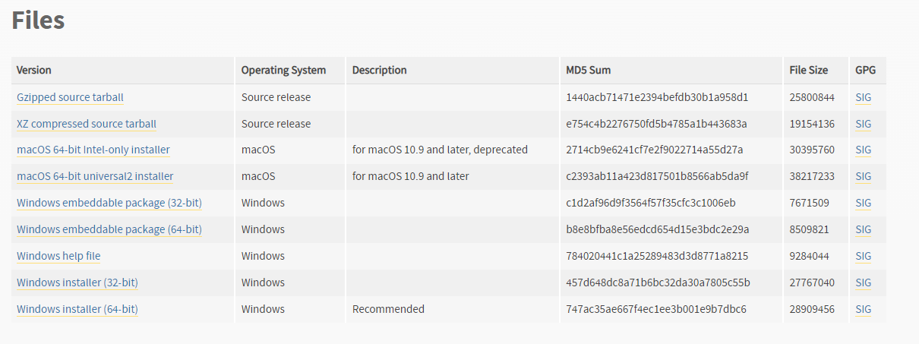
Pycharm|Install
2, Download and Install Python
Search download Python in google or access https://www.python.org/downloads/
Download lastest version
Choose and click all options when you install this PGM
Example (1)
Roll to the end of page (2)
Choose your Window Installer (3)
2 / 7

Slide 4
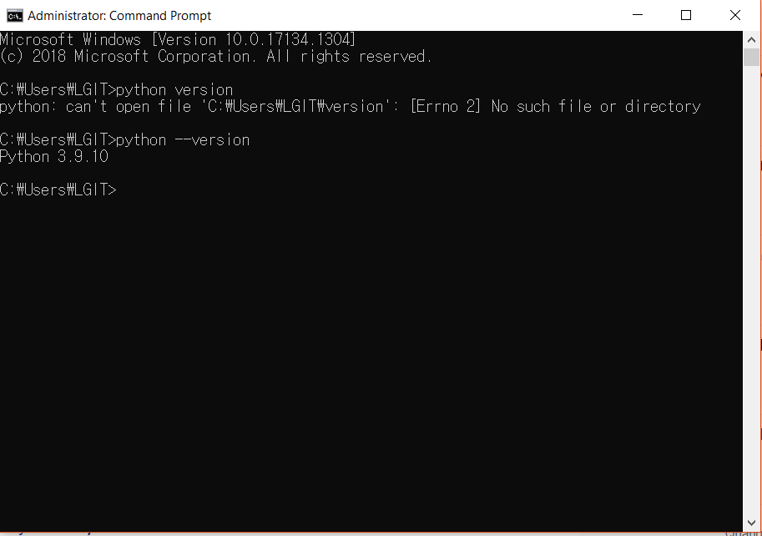
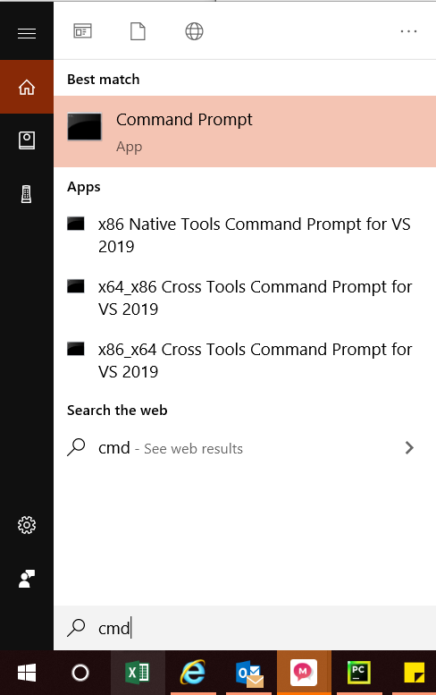
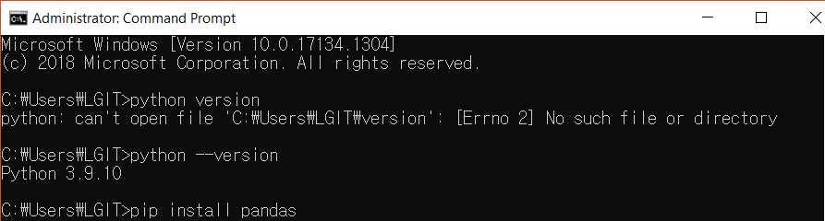
Pycharm|Install
3, PIP Install environments into python by cmd
Library
Open “Command Prompt”
Write as image
pip install pandas
pip install openpyxl
pip install xlsxwriter
pip install matplotlib
pip install seaborn
pip install pillow
pip install opencv-python
Open “Command Prompt”
python --version

Slide 5
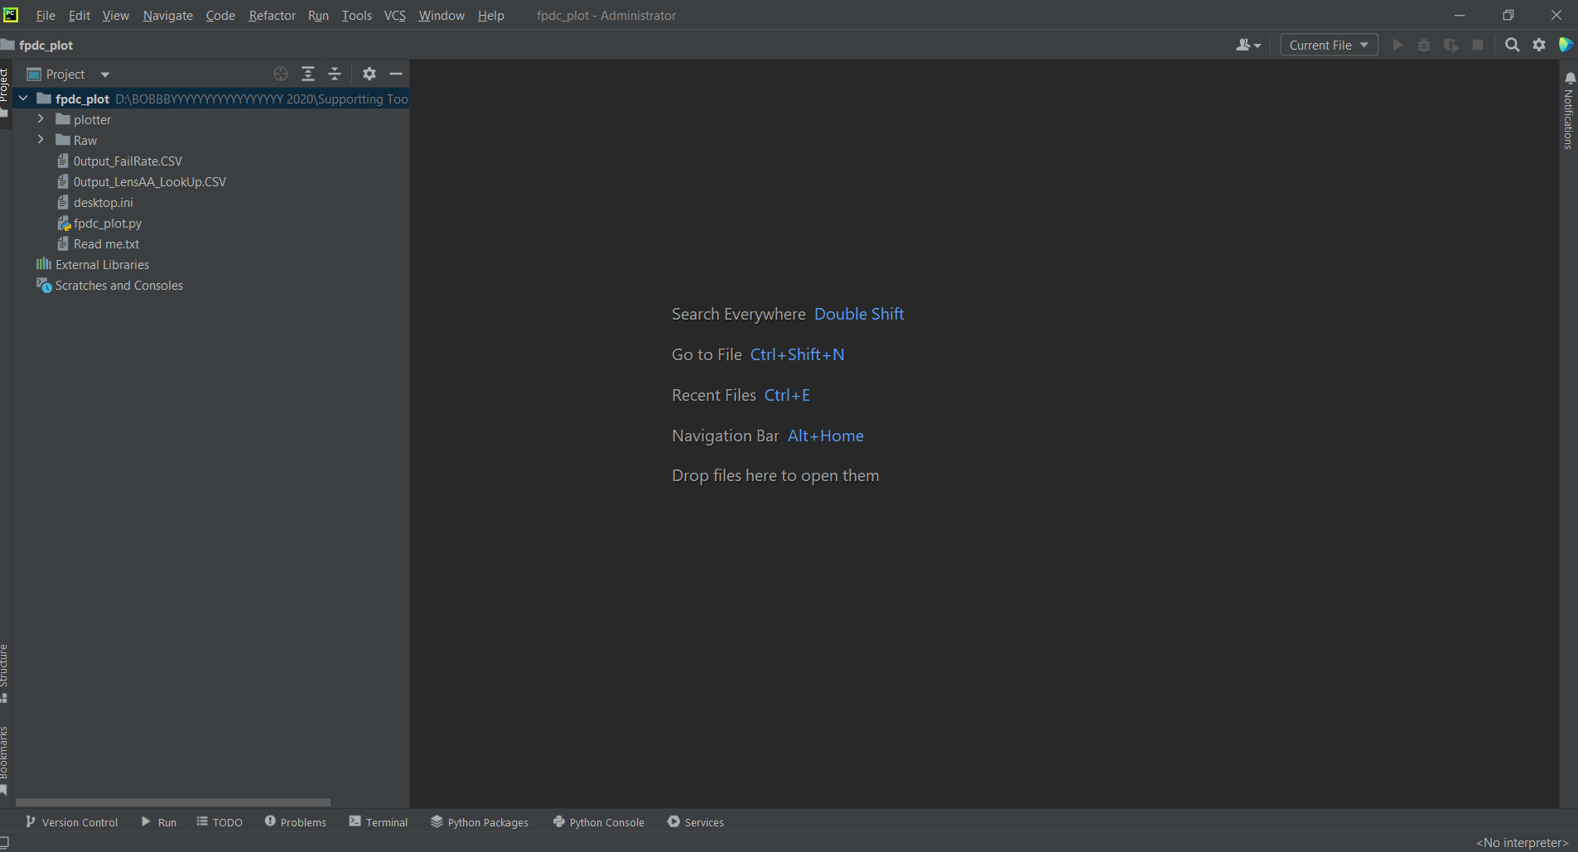
Pycharm|How to run
4, Run Python script
Input script and interpreter to run the SCRIPT.
No Input script for running
No script
NO INTERPRETER

Slide 6
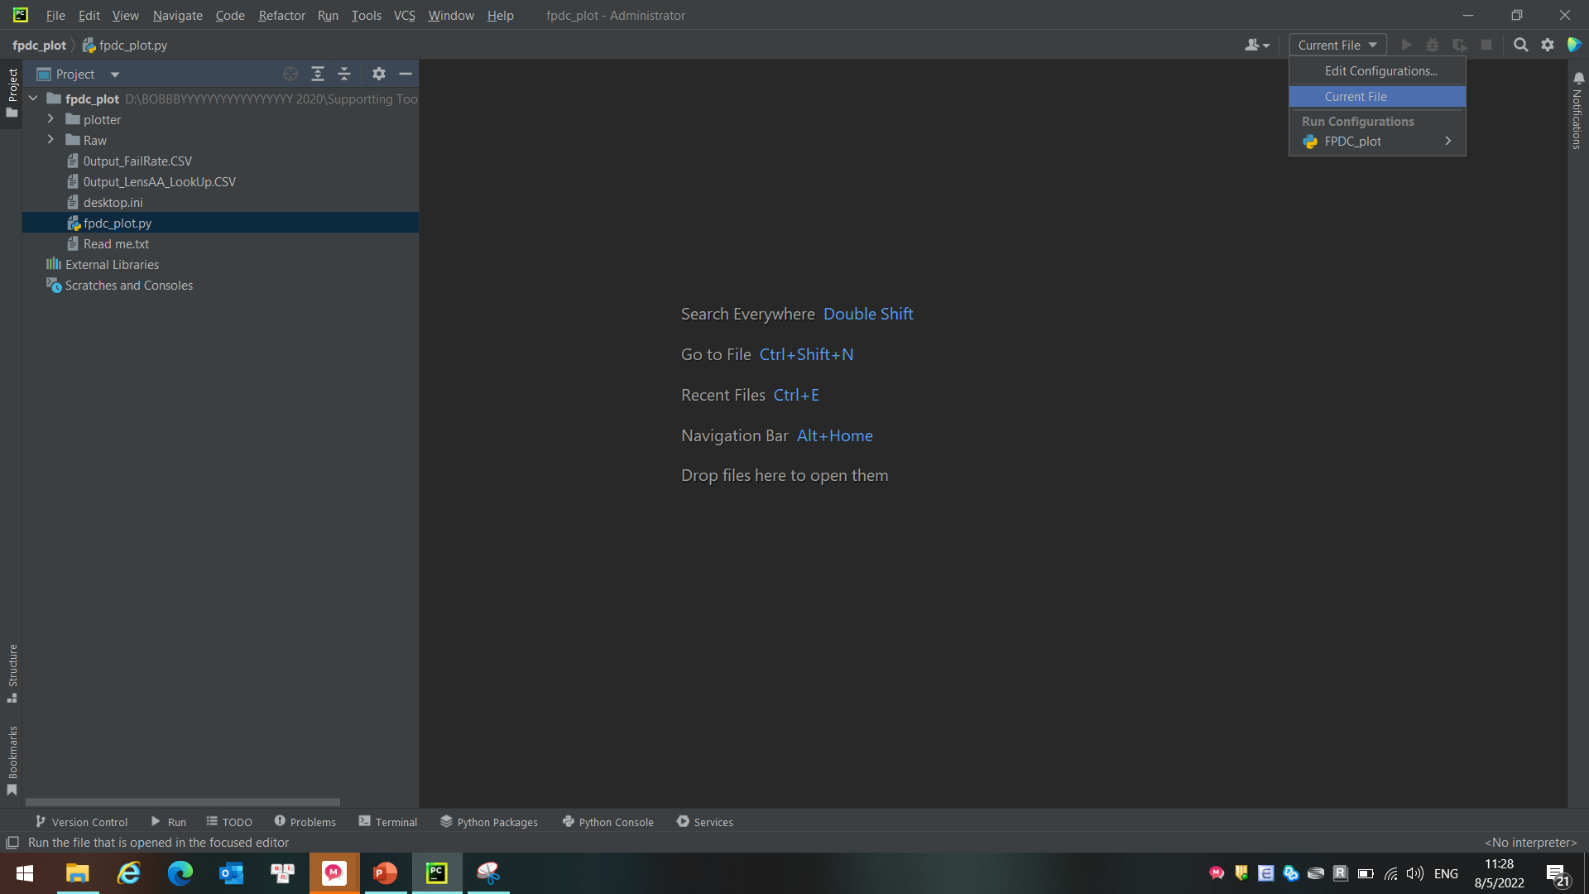
Pycharm|How to run
4, Run Python script
Drag the script and add current file.
Drag this script to here
Click Edit Config

Slide 7
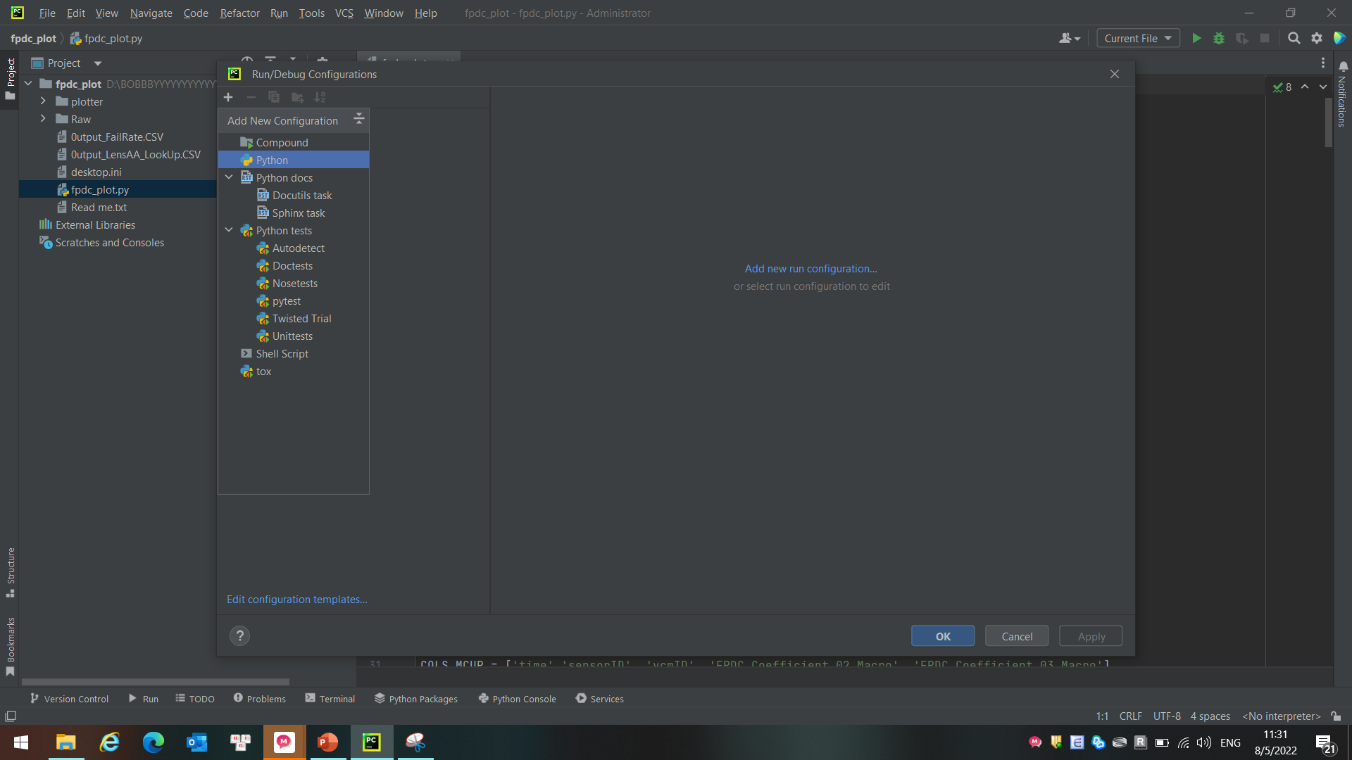
Pycharm|How to run
4, Run Python script
Input Run/Debug config
#1
#2

Slide 8
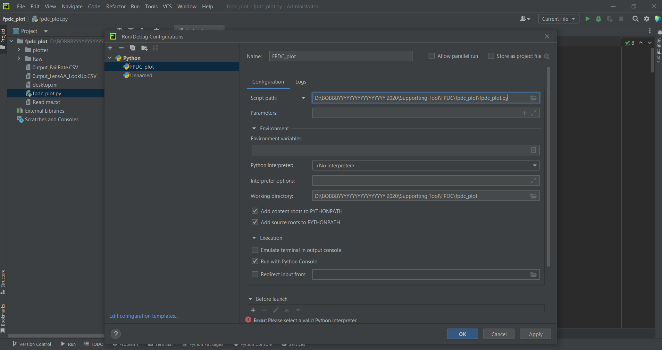
Pycharm|How to run
4, Run Python script
Follow the sequence from #1 to #6
#1
#2
#3
#4
#6
#5

Slide 9
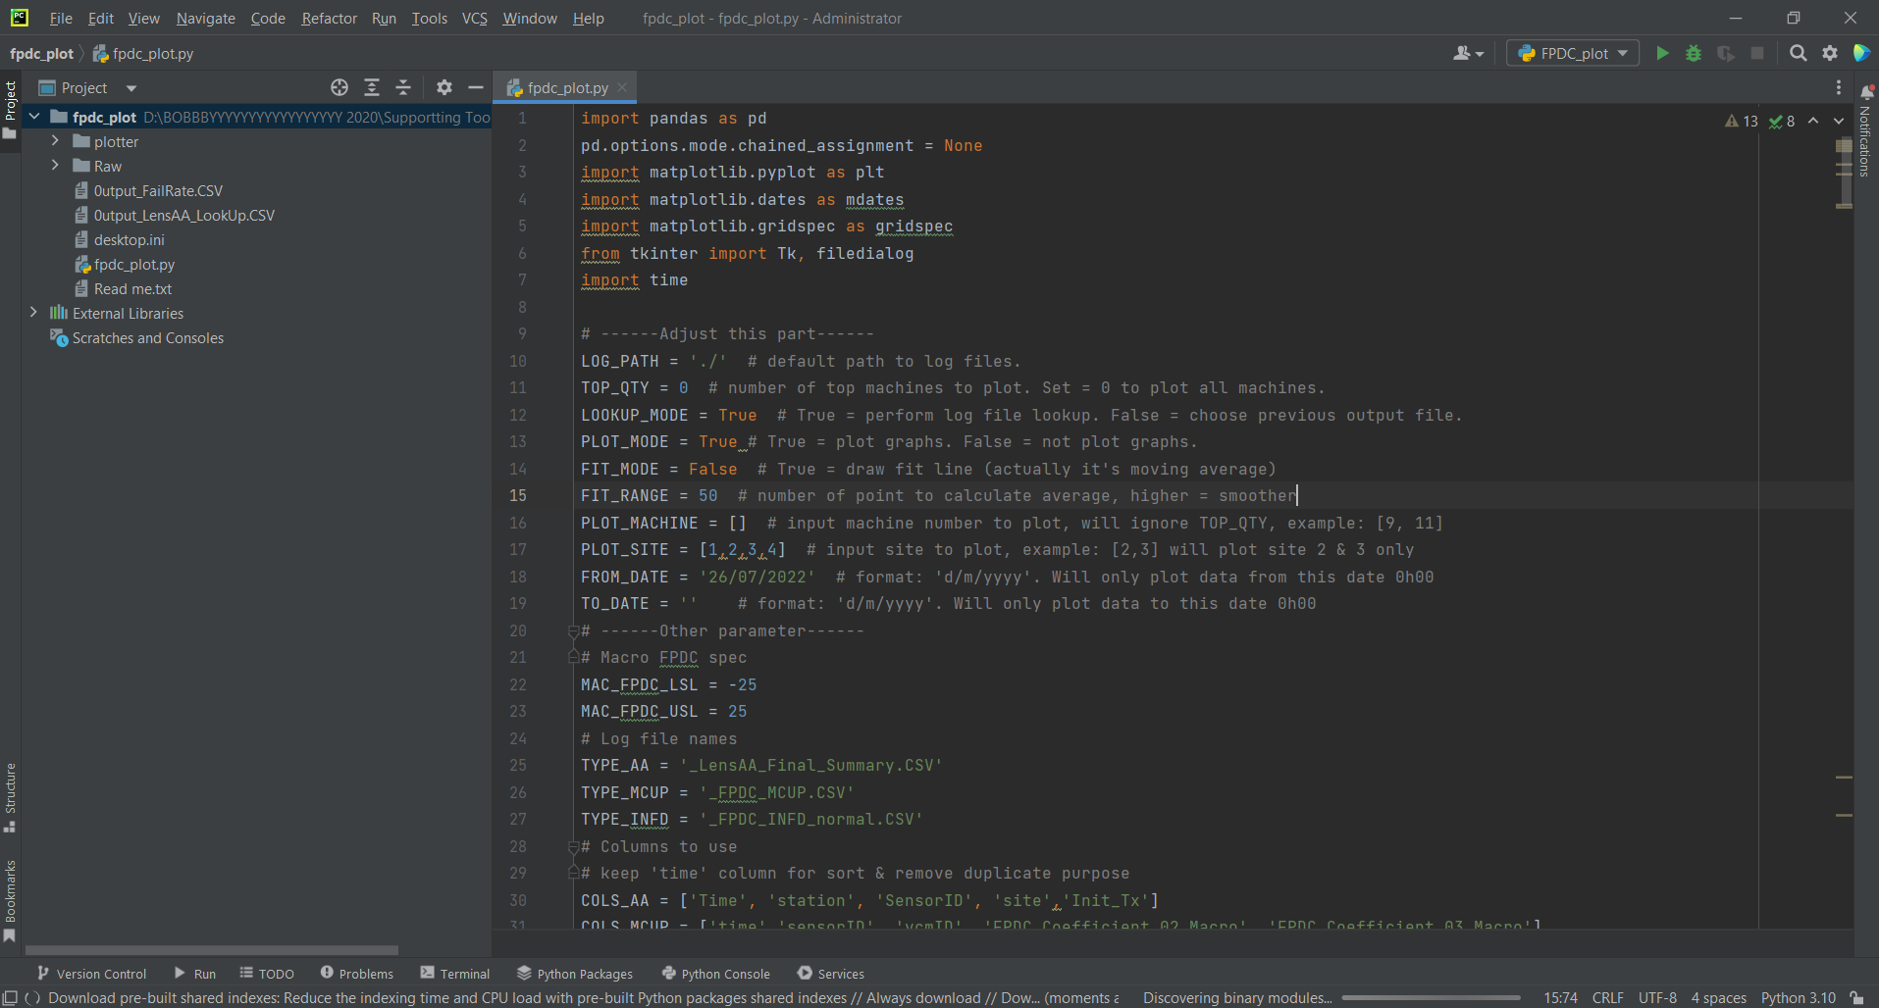
Pycharm|How to run
4, Run Python script
Can run normally after script and interpreter were added.
Inputted Script and can click Run normally
INTERPRETER is added

